Slide 1
Moseley Litterbusters
Formed in 2017 by Izzy Knowles, we are a group of volunteers who want to help make Moseley cleaner and more attractive through:
Organising litter picking events
Removing graffiti by cleaning and overpainting
Reporting flytipping and graffiti
Promoting clean streets through poster campaigns
Engaging with local residents, businesses, schools, community groups and Birmingham City Council.

Slide 2

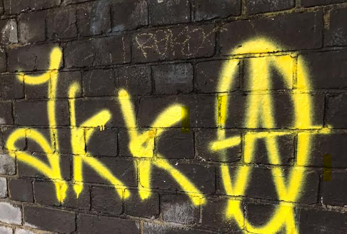
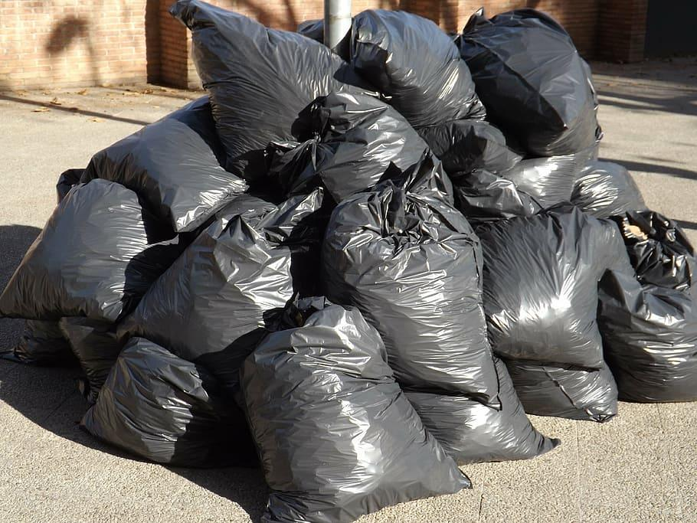
Moseley Litterbusters in Numbers
5 in our admin team
30 regularly picking
67 on WhatsApp
687 on Facebook
1,515 bags this year
11,600 bags (80 tonnes) since 2021
2,300 N20 canisters since 2022
100s of reports to council on litter, flytipping, graffiti
20+ utility boxes painted to remove graffiti

Slide 3
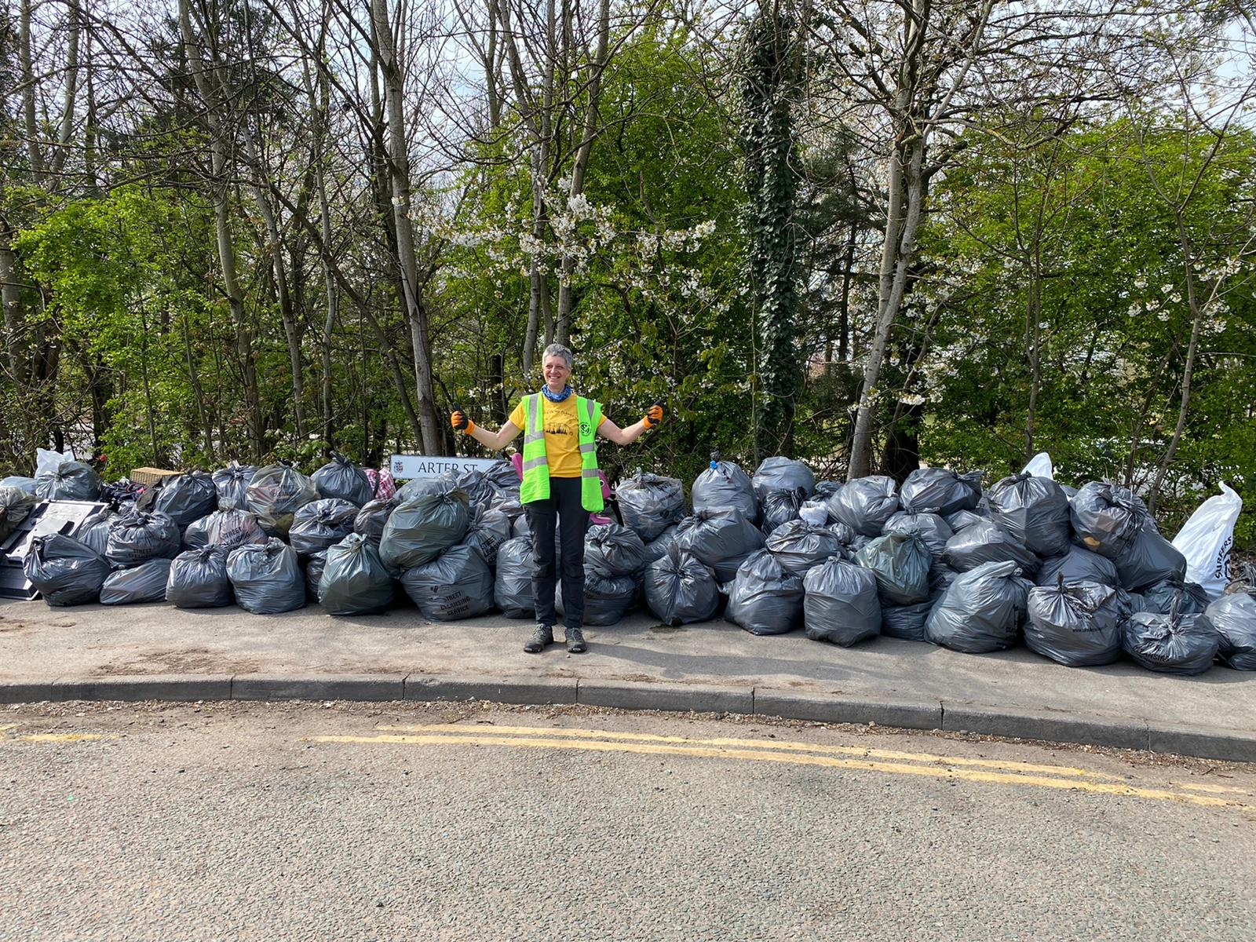
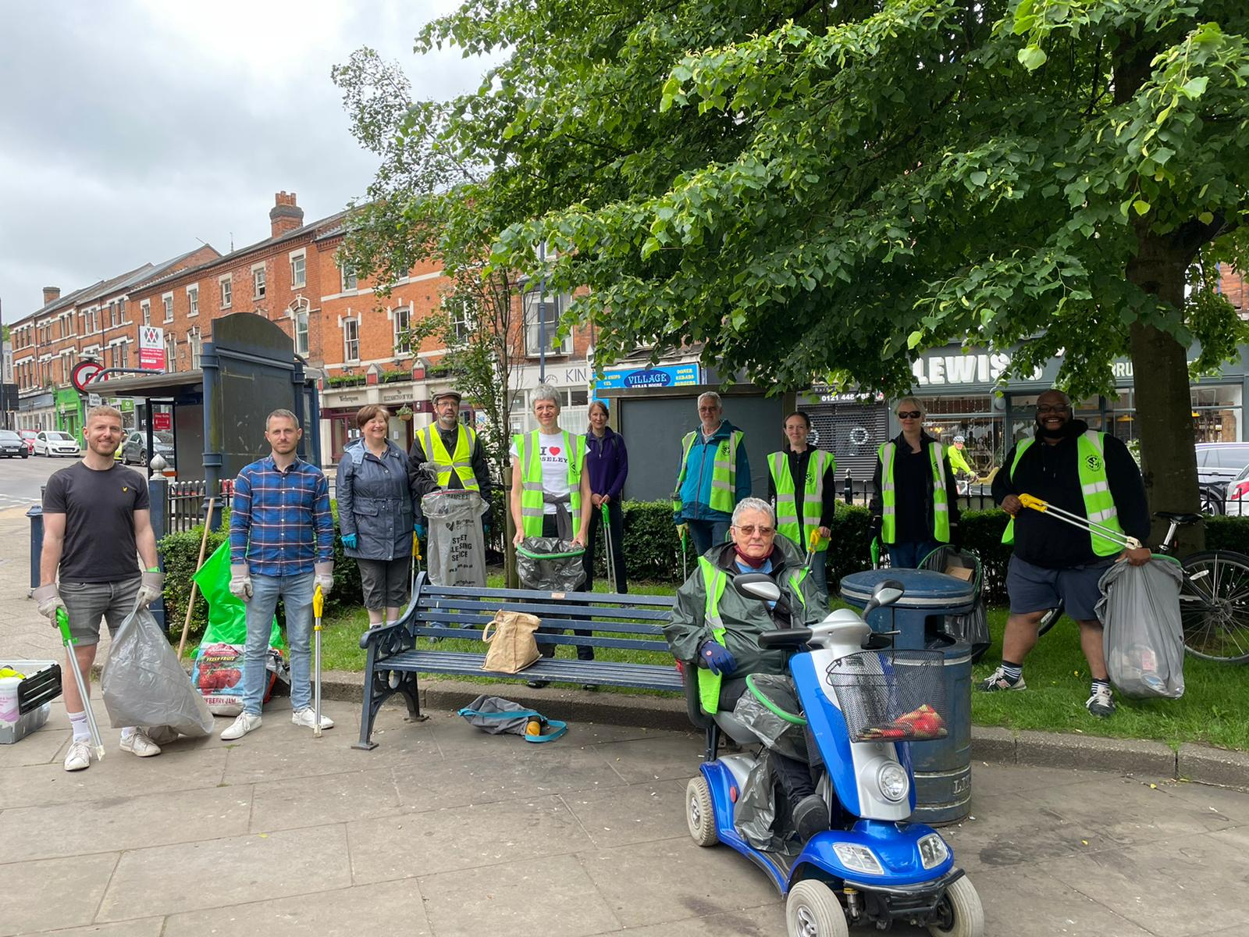
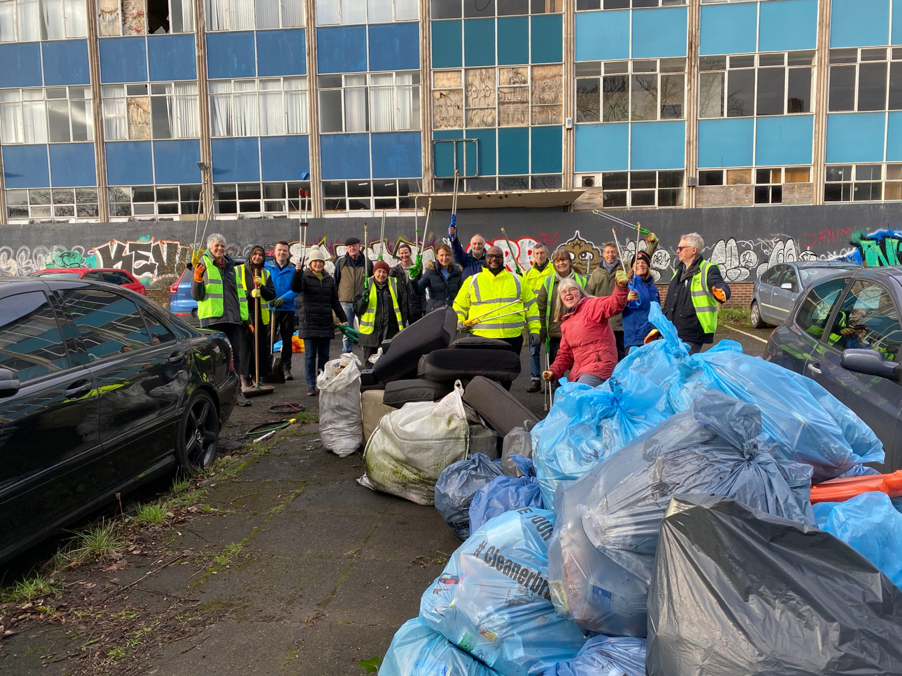
Moseley Litterbusters
130 bags! (Haden Way clean)
Sunday in the village
Another massive haul! (Malcolm House)

Slide 4
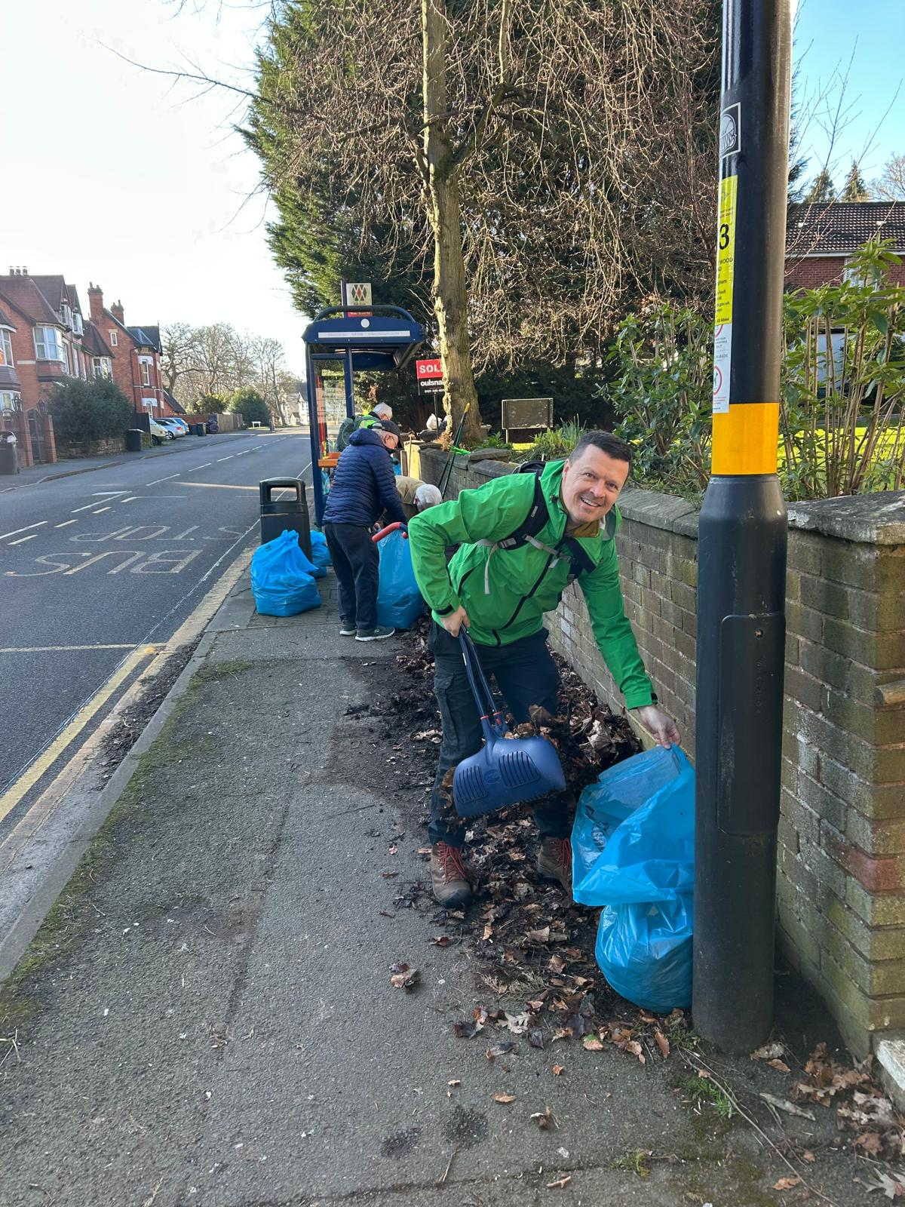
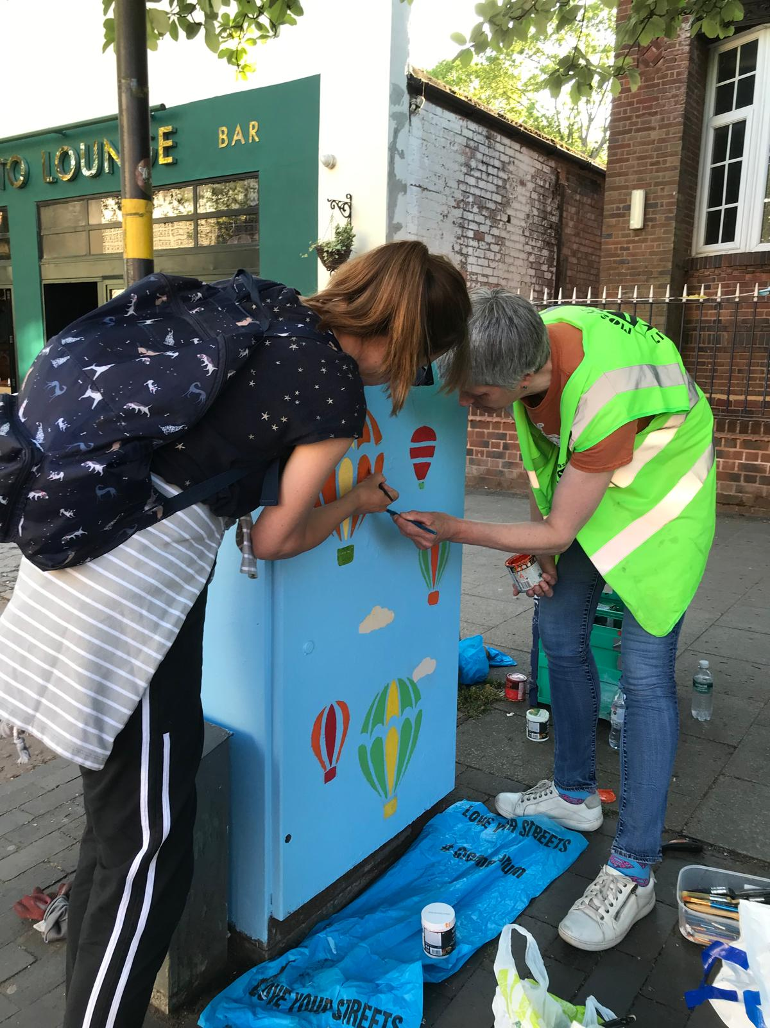
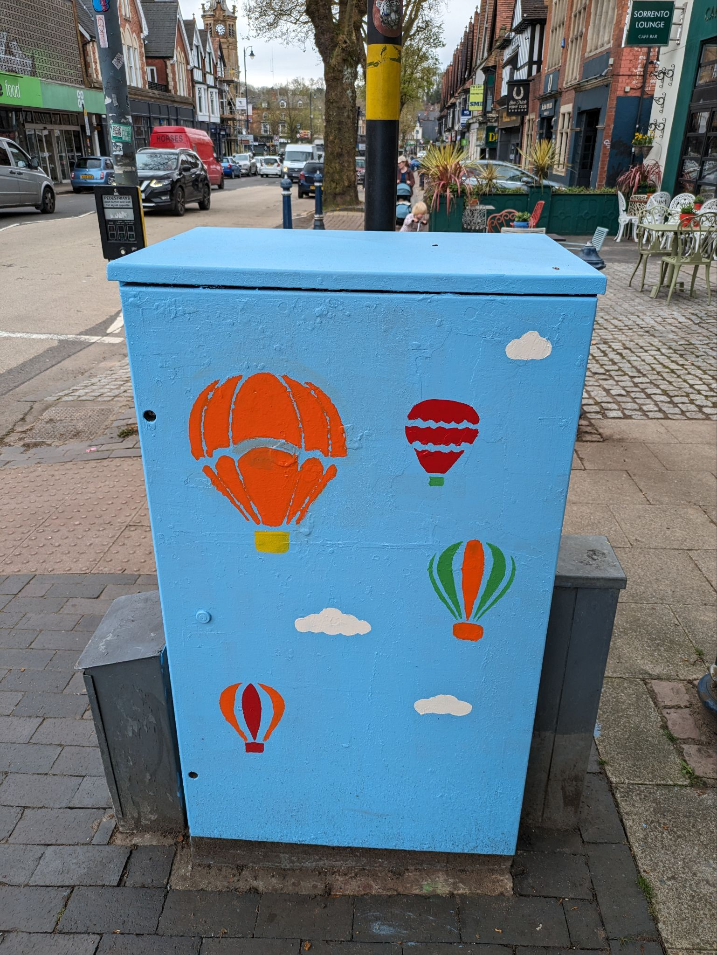
Moseley Litterbusters
Leaf clearance
(Yardley Wood Road)
Painting over graffiti
(Moseley Village)

Slide 5
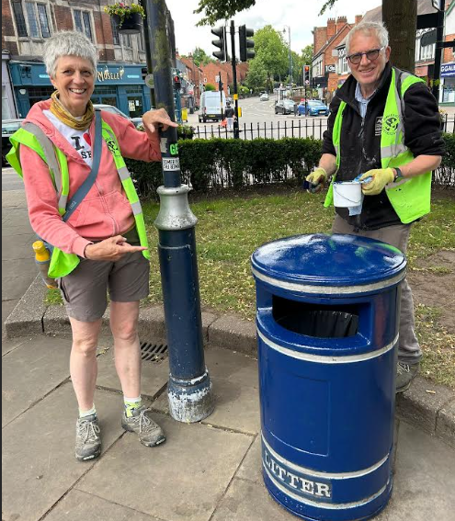
Want to get involved?
Please join us by emailing moseleylitterbusters@gmail.com or scan the QR code on one of our posters/cards.
We provide litter picking equipment on loan
or for sale (at cost price) and litter sacks.
Choose to pick solo or join our organised sunday
picks or occasional evening meet ups.
No commitment to attend every week!
We can also put you in touch with other litter
groups in our area:
Moor Green; Kings Heath; Billesley; Bradford Street; Balsall Heath

Slide 6


Slide 7
Questions for Councillor Mahmood
How many mechanical sweepers are available and can we see them used more frequently?
The collection of commercial waste is repeat issue at many premises - what can the council do to improve this?
The litter on the main routes (and in particular the grass central reservations on the ring road) creates a bad impression for visitors to the city - how often are these supposed to be cleaned?
Can litter (especially cans) be picked up before grass cutting? It shreds it into tiny pieces making it difficult for volunteers to clean up!
A recent news article stated that flytipping had doubled in Birmingham. Not surprising but the numbers quoted seemed massively underestimated - did the information exclude reports via fix my street?
Does the council have any plans to address the litter problem caused by the lack of adequate bins in some terraced housing and in HMOs?

Slide 8
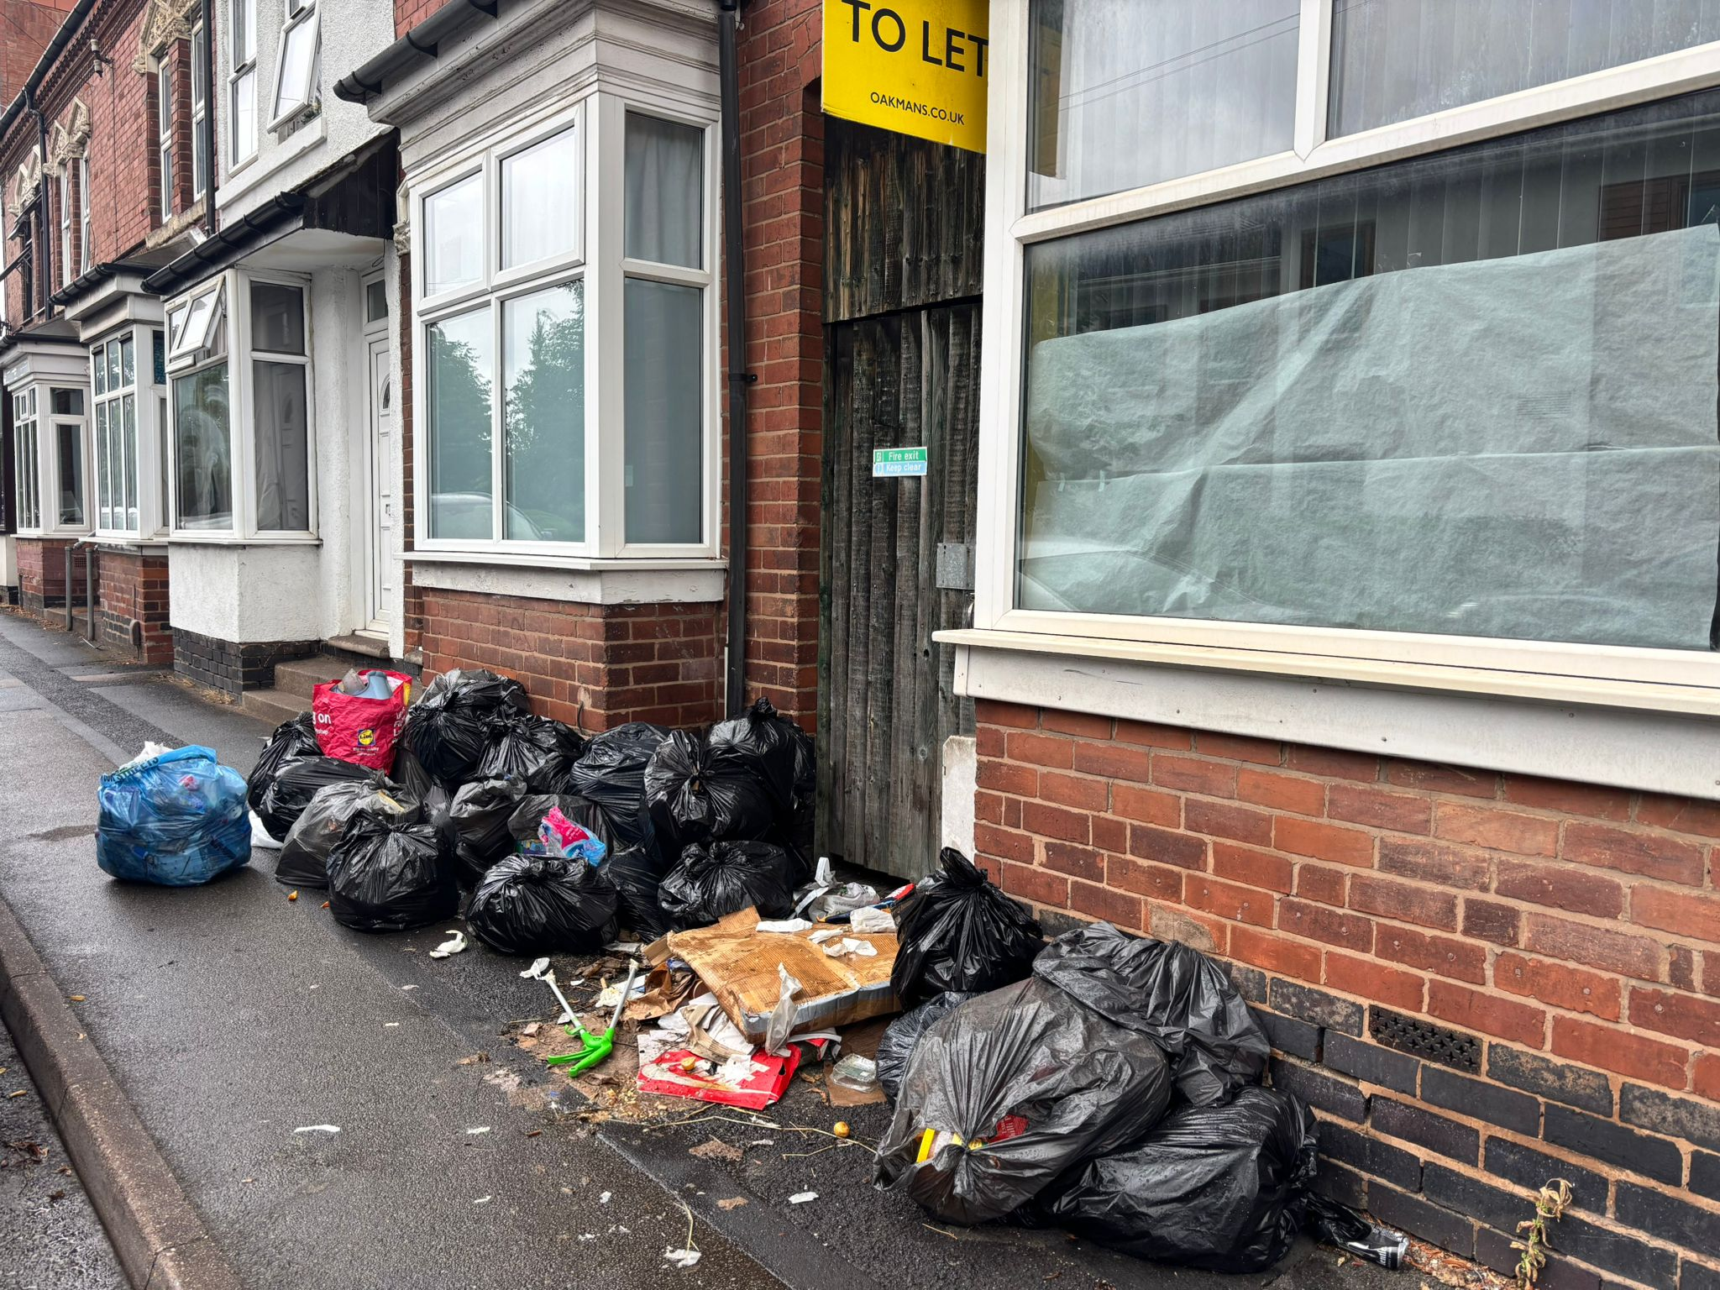
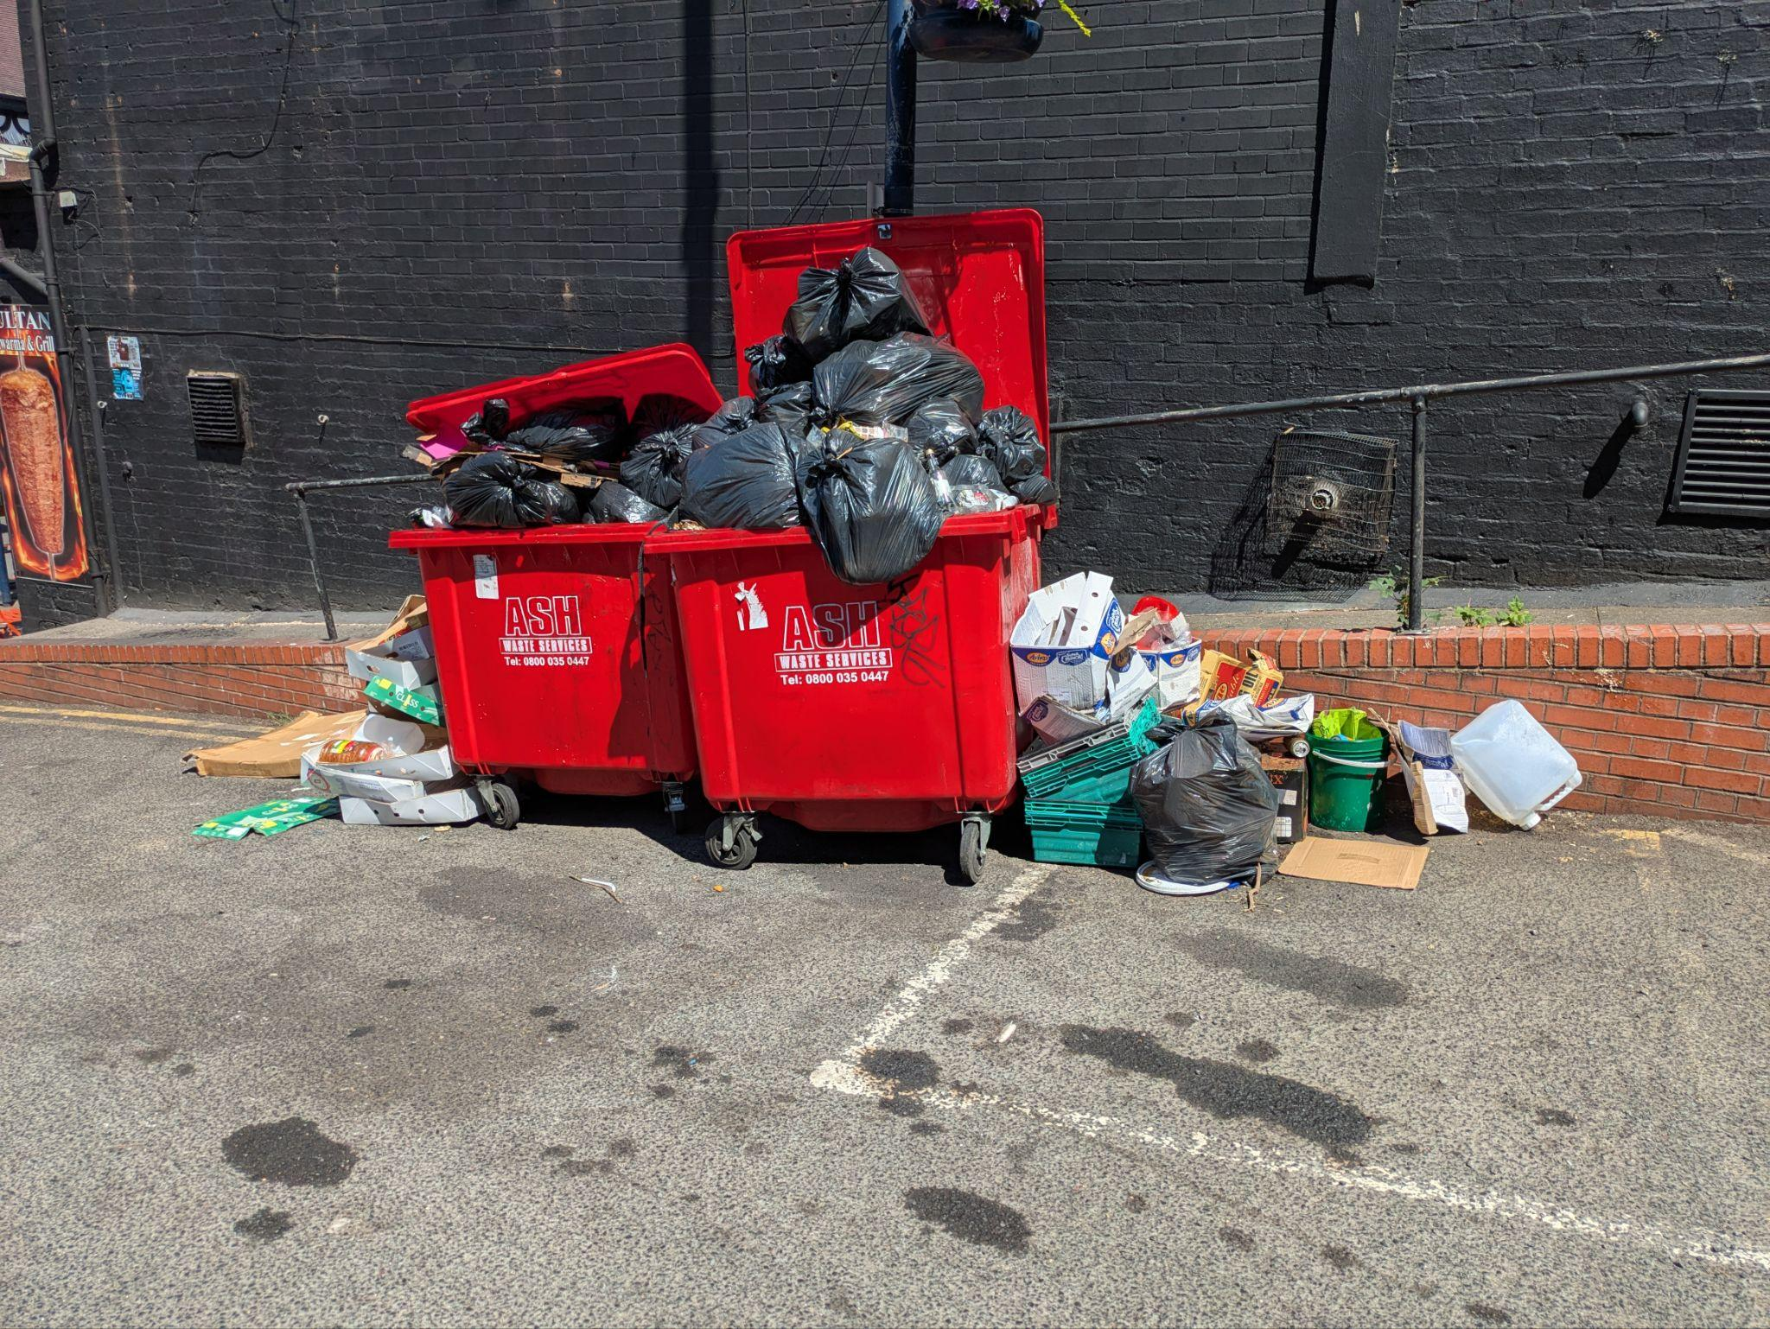
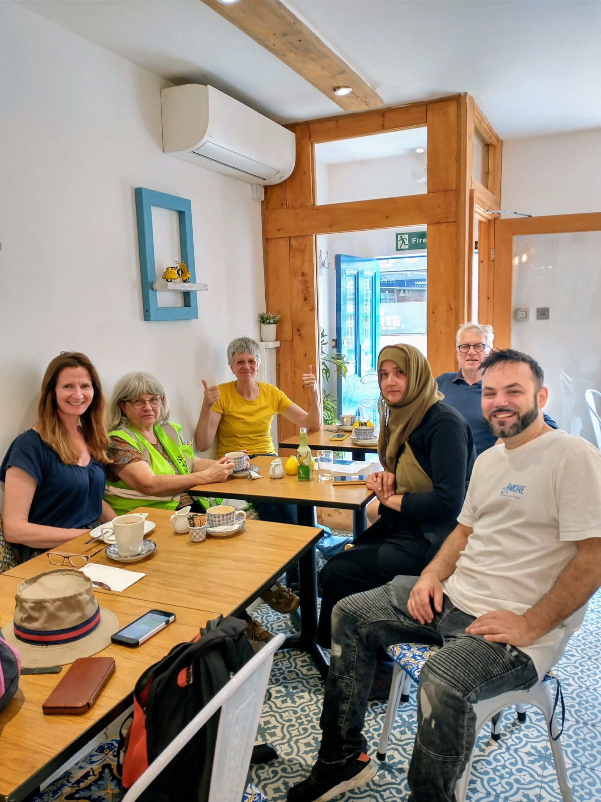
Moseley Litterbusters
Commercial waste issues
Sometimes we have a break!
Houses without bins

